Slide 1
Network Pruning
Dr. Yan Yan

Slide 2
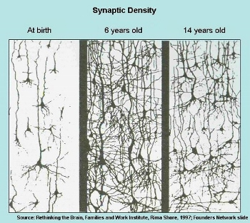
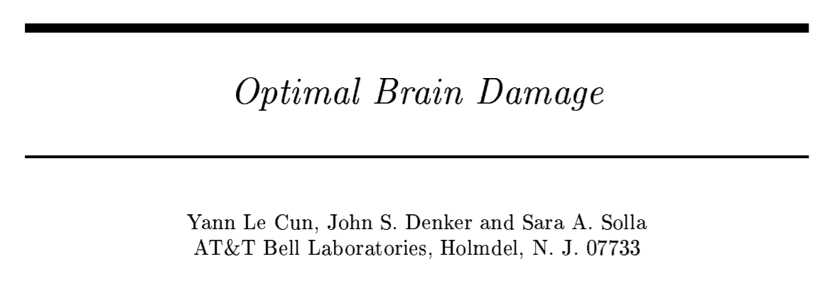
Network can be pruned
Networks are typically over-parameterized (there is significant redundant weights or neurons)
Prune them!
(NIPS, 1989)

Slide 3
Network Pruning
Pre-trained
Network
Importance of a weight:
large
absolute values, life long …
Evaluate the Importance
Importance of a neuron:
the number of times it wasn’t zero on a given data set ……
Remove
After pruning, the accuracy will drop (hopefully not too much)
smaller
Fine-tune
Fine-tuning on training data for recover
Small enough?
Don’t prune too much at once, or the network won’t recover.
Smaller Network

Slide 4
Network Pruning - Practical Issue
Weight pruning
The network architecture becomes irregular.
Prune some weights
0
Hard to implement, hard to speedup ……

Slide 5
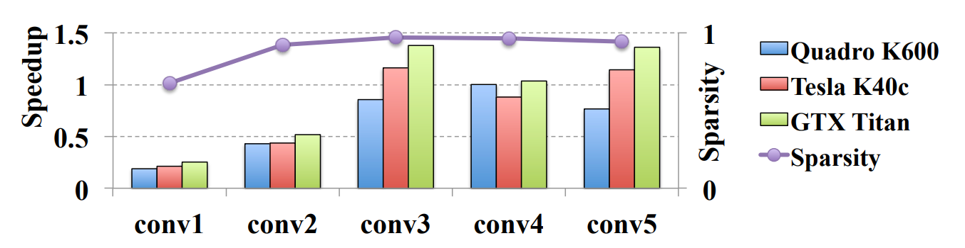
Network Pruning - Practical Issue
Weight pruning
https://arxiv.org/pdf/1608.03665.pdf

Slide 6
Network Pruning - Practical Issue
Neuron pruning
The network architecture is regular.
Prune some neurons
Easy to implement, easy to speedup ……

Slide 7
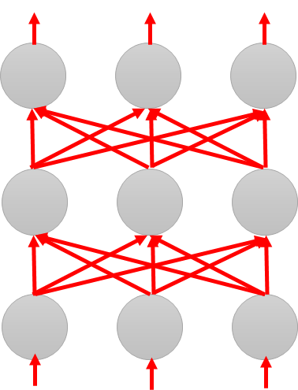
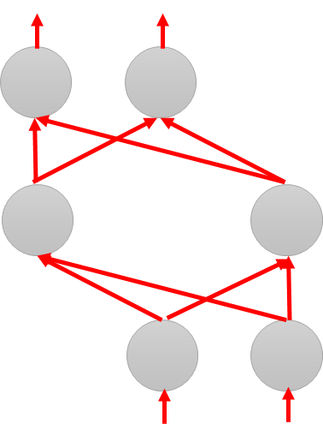
Why Pruning?
Lottery Ticket Hypothesis
Large Network
Train
Large Network
Win!
Train
Sub-
network
Sub-
network
Win!
Sub-
network
Train
Sub-
network
……
……

Slide 8
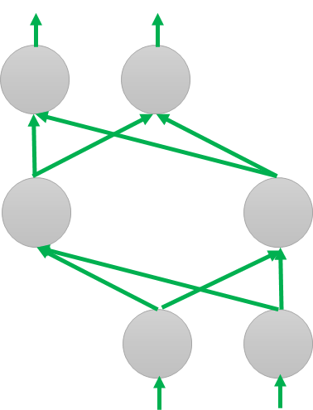
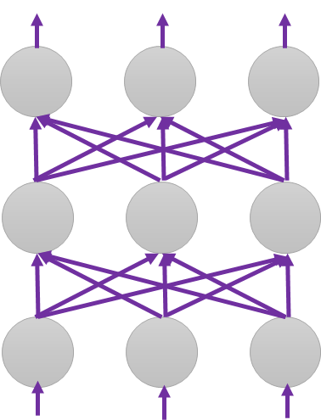
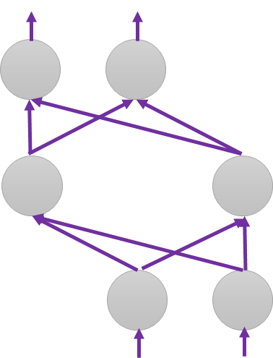
Why Pruning?
Lottery Ticket Hypothesis
Random init
Again
Original
Random init
Random init
Trained
Pruned
Random Init weights
Trained weight
Another random Init weights

Slide 9
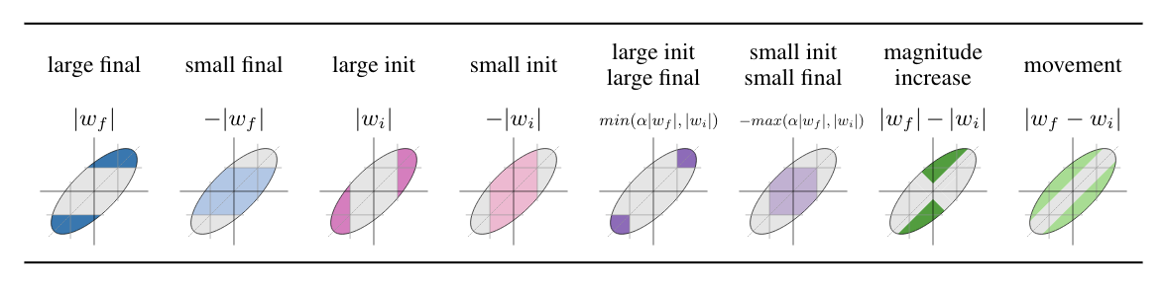

Why Pruning?
https://arxiv.org/abs/1905.01067
Lottery Ticket Hypothesis
Different pruning strategy
Deconstructing Lottery Tickets: Zeros, Signs, and the Supermask
https://arxiv.org/abs/1905.01067
“significance” of initial weights: Keeping the sign is critical
0.9, 3.1, -9.1, 8.5 ……
+$α$, +$α$, - $α$, +$α$ ……
Pruning weights from a network with random weights
https://arxiv.org/abs/1906.04358

Slide 10
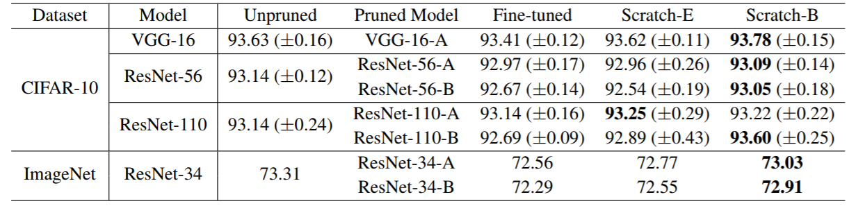
Why Pruning?
Rethinking the Value of Network Pruning
https://arxiv.org/abs/1810.05270
New random initialization, not original random initialization in “Lottery Ticket Hypothesis”
Limitation of “Lottery Ticket Hypothesis” (small lr, unstructured)

